Slide 1
The Pediatric Resident Burnout – Resilience Study Consortium Update – Feb 2018 Focus on 2018 Annual Study
Maneesh Batra, MD and John D Mahan MD for the PRB-RSC Steering Committee

Slide 2
Agenda
State of the Consortium:
Sites
Ongoing Studies (2018 Annual Survey, others)
2017 study results - PD reports
PRB-RSC Research Request Process
PRB-RSC survey re-design – for 2019
Interventional trials for 2018-2019
PRB-RSC web site - content for Repository of Best Wellness Practices; other improvements?
Potential new collaborations/projects using PRB-RSC framework
PRB-RSC meeting at Spring APPD 2018 Meeting

Slide 3
PRB-RSC
Steering Committee
Maneesh Batra, MD, MPH
John D Mahan, MD
Kathi Kemper, MD, MPH
Hilary McClafferty, MD
Betty Staples, MD
Chuck Schubert, MD, MPH
Janet Serwint, MD, MPH
Paria Wilson, MD

Slide 4
APPD LEARN
APPD LEARN (Longitudinal Educational Assessment Research Network)
Provides infrastructure for multicenter, collaborative pediatric educational research
Approved by APPD LEARN Protocol Review Committee
Study Assistance
Provide IRB kits and help
Provide Data Capture system and enrolling emails and links
Provide feedback on enrollment activity
Assist in presentations
Assist in data analysis and sample manuscript language

Slide 5
PRB-RSC Goal
To improve pediatric resident resilience, compassion, confidence in providing calm, compassionate care and wellness. Through creation of a Pediatric Resident Burnout - Resilience Study Consortium (PRB-RSC), involving pediatric residents in 58 residency programs [57 Peds & 16 Med Peds] in the US, we will be equipped to study the epidemiology, natural history and impact of interventions designed to address burnout and resilience in pediatric residents.

Slide 6
State of the Consortium: Sites, Studies
58 Sites
Projects 1, 2, 3 – updates
Abstracts submitted/planned; manuscripts
Opportunities for Scholarship

Slide 7
2018 PRB-RSC Sites 58 sites; 46 contributed to 2017 Annual Survey
Albert Einstein College of Medicine
Baylor/Texas Children’s
Boston Combined Program
Carolinas Medical Center
Case Western/Rainbow Babies/Children
Children’s Hospital at Erlanger
Children’s Hospital of Philadelphia/ Pennsylvania
Children’s Hospital of Pittsburgh
Children’s Mercy
Cornell/NY Presbyterian
Crozer-Chester Medical Center
Duke University
Dartmouth University
duPont Hospital
Einstein/Montefiore
Indiana University
Inova Fairfax Medical Campus
Johns Hopkins University
Louisiana State University
Maine Medical Center
Mayo Clinic College of Medicine
Medical College of Wisconsin
Nationwide Children's/The Ohio State University
Newark Beth Israel
Rush University
Shands Hospital/Florida
Stanford University
St Christopher’s Hospital
Stroger Hospital of Cook County
Tufts Medical Center
Tulane
U of Alabama
U of Arizona
U of California Davis
U of California Los Angeles
U of California San Diego
U of Chicago/Corner Children’s Hospital
U of Cincinnati/Cincinnati Children’s
U of Colorado/Denver Children's
U of Illinois Chicago
U of Kansas
U of Louisville
U of Michigan
U of Minnesota
U of New Mexico
U of North Carolina
U of Oklahoma
U of Oklahoma- Tulsa
U of Rochester
U of South Alabama
U of Tennessee
U of Texas Austin
U of Texas Houston
U of Washington/Seattle Children's
U of Wisconsin
Vanderbilt
Virginia Tech/Carilion Clinic
Wright State/Dayton’s Children’s Hospital

Slide 8
2018 New PRB-RSC Sites 3 new sites
Children’s Hospital of Michigan | Jackie Leja, MD
University of Texas Austin Dell’s Children’s Hospital | Kartik Pillutla, MD, FAAP
University of North Carolina | Eric Zwemer, MD
Invited PAS 2018 Science Plenary: Promoting resilience among pediatric trainees and practitioners – Constructing and assessing the evidence for effective interventions PRB-RSC Steering Committee Members

Slide 9
Consortium Projects
1. Defining Key Factors In Burnout and Resilience in Pediatric Residents and The Relationship To Performance
Phase 1 Study – Defining Key Factors in Burnout and Resilience in Pediatric Residents (Batra/Mahan, in preparation) Phase 2 Study – Establishing Relationship of Pediatric Resident Burnout to Performance (Staples/Serwint, in preparation)
2. Pediatric Resident Burnout and Resilience Study Consortium: National Landscape of Interventions to Improve Pediatric Resident Wellness and Reduce Burnout (Wilson/Kemper – Acad Peds 2017)
3. Variability of Burnout and Stress Measures in Pediatric Residents: an Exploratory Single Center Study from the Pediatric Resident Burnout – Resilience Study Consortium (Reed/Mahan, submitted)

Slide 10
Consortium Projects – In Works
4. Do Mindfulness and Self-Compassion Predict Stress, Burnout, and Confidence in Providing Compassionate Care in Pediatric Residents? (Kemper/McClafferty)
5. Burnout in pediatric global health participants: a look at national trends from the PRB-RSC (Lauden/Schubert)
6. How is Resilience Shaped in Pediatric Residents: Insights from the PRB-RSC Study (Mahan/PRB-RSC PIs)
7. Utility of Two-Item Burnout Assessment in Defining Burnout in Pediatric Residents: A PRB-RSC Study (Schwartz/Kemper/PRB-RSC PIs)
8. Discussed but not Submitted
Spirituality (Pitt)
Mindfulness (Sox)

Slide 11
2018 New PRB-RSC Presentations APPD/PAS
APPD – 3 abstracts accepted
PAS – 3 abstracts accepted
Invited PAS 2018 Science Plenary:
Promoting resilience among pediatric trainees and practitioners – Constructing and assessing the evidence for effective interventions (PRB-RSC Steering Committee Members)

Slide 12
PRB-RSC National Surveys
2016
2017
62% (1693/2723) of eligible residents from 34/46 programs responded
Over 80% of programs >50% response rate
Burnout rate = 56%
Respondents: 72% female, 71% white, 17% had children, 62% > $100,000 debt, 59% married/ partnered, mean age 29 years
66% (2179/3273) from 43/46 programs in 2017
Over 80% of programs had >50% response rate
Burnout rate = 54%

Slide 13
PRB-RSC National Surveys
No significant differences between residents based on presence of burnout or survey year
Burned out residents reported:
increased : stress, worse mental health
decreased: empathy, mindfulness, resilience, self-compassion, confidence in providing compassionate care (all p<0.05).
Protective programmatic factors:
current rotation (ambulatory/elective/research)
decreased sleepiness
temporal relationship to most recent vacation or weekend off
lack of recent involvement in a medical error (all p<0.05).

Slide 14
Next Major Study - Longitudinal Study (Project 3) -- 2018 Survey
Same timing as 2016 and 2017 survey; same items
More sites
Methods - Engagement
IRB Kit from Beth King (APPD LEARN)
Any questions, contact Batra/Mahan or Beth King (APPD LEARN)

Slide 15
Recruitment and Enrollment
6 week window anticipated (April 15 – May 31, 2018)
Programs may elect to keep window open longer
Recruitment strategies
High recruitment is key for powering this study
Programs are encouraged to employ their own recruitment strategies (including inducements)
Residents respond to engagement of Program Leadership and commitment to address wellness
Inducements can be locally applied
APPD LEARN will facilitate reminders to non-respondents

Slide 16
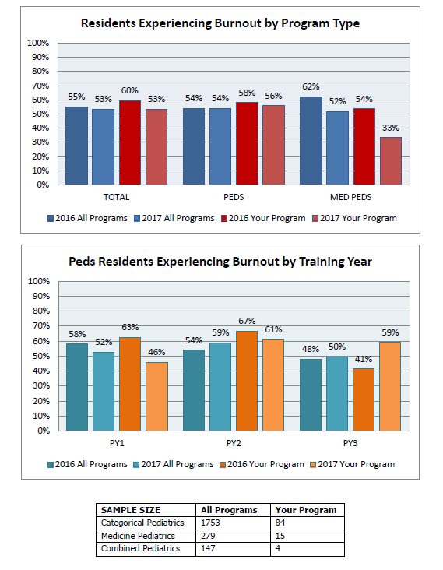
2017 Study Results - PD Reports
Enhanced
Customized reports: can be developed by PRB-RSC Program Director Standard Reports Working Group (Co-Chairs: Betty Staples & Jason Homme)

Slide 17
PRB-RSC Research Request Process
PRB-RSC Scholarship WG
Loads of data waiting!
Request Form to be posted in web site soon
Value of SC Mentor – please contact us (by email of through web site) to arrange/discuss

Slide 18
PRB-RSC Survey Re-Design 2019
Plan to convene PRB-RSC Working Group in 3rd Quarter 2018 to analyze survey results, items and design new annual survey
Less items
New areas of inquiry

Slide 19
Interventional Trials for 2018-2019
Interest?
Mechanism?
Steering Committee happy to consult, facilitate

Slide 20
PRB-RSC Web Site
Content for Repository of Best Wellness Practices
Requests
Other improvements?

Slide 21
Potential New Collaborations/Projects Using PRB-RSC Framework

Slide 22
PRB-RSC Meeting at Spring APPD 2018 Meeting
Please attend and contribute

Slide 23
PRB-RSC Website
http://pedsresresilience.com

Slide 24
Future Developments
Interventional Trials – 2018?
Collaborations (Faculty/Trainee Surveys?)
International

Slide 25
Questions

