Slide 1
Burnout in Pediatric Residents A National Survey to Inform Future Interventions
John D Mahan, Maneesh Batra, Kathi J. Kemper, Hilary McClafferty, Charles Schubert, Janet Serwint, Betty Staples, Paria Wilson, Alan Schwartz.
For the Pediatric Resident Burnout – Resilience Study Consortium
http://pedsresresilience.com

Slide 2
All authors have documented that we have no financial relationships to disclose or Conflicts of Interest (COIs) to resolve

Slide 3
Background
Suboptimal patient care
Decreased patient satisfaction
Impaired resident performance
Decreased job satisfaction
Poor resident health: mental, physical
Resident Burnout
Prins, Med Teach 2007; Wallace, Lancet 2009; Dyrbye, JAMA 2010; Baer, Pediatrics 2017, Mahan Pediatrics 2017
Notes:
Prevalence of burnout among peds residents: 46-74%
Limited by small sample sizes, low response rates, and minimal assessment of demographic characteristics and risk factors/impacts
Less is known about combined (e.g., Med-Peds)
Knowledge gaps remain:
National prevalence, distribution and natural history
Understanding individual and institutional protective/risk factors to target future interventions

Slide 4
Pediatric Resident Burnout-Resilience Study Consortium (PRB-RSC)
How: Established in 2015
Why: Goals:
To improve pediatric resident resilience and attributes of wellness
Describe the epidemiology and relationships between burnout, resilience, and attributes of wellness
Test interventions that positively impact burnout, resilience, and attributes of wellness

Slide 5
PRB-RSC Participating Sites
2016 = 31 sites
2017 = 43 sites

Slide 6
Survey Tool
Total of 141 items, 12-15 min to complete
Demographics & Residency Characteristics
Age, Race
Gender
Marital status
Debt
Year of training
Proximity to weekend and vacation
Type of rotation
Recent experiences (e.g., night call, patient death)
Attributes of Wellness
Burnout (MBI)
Resilience
Stress
Mindfulness
Self-compassion
Empathy
Sleepiness
Career satisfaction
Notes:
MBI: Considered criterion standard for measuring burnout
Validated 22-item questionnaire
3 subscales: Depersonalization (DP), Emotional Exhaustion (EE), Personal Accomplishment (PA)
By convention, high score in DP (≥ 27) or EE (≥10) is considered ‘burned out’

Slide 7
Key Findings
PRB-RSC 2016 Findings
34 programs (22 with both peds and med-peds)
Overall response rate: 62% (1693/2723)
Overall prevalence of burnout: 56%
Burnout did not differ by program size
PRB-RSC 2017 Findings
43 programs (23 with both peds and med-peds)
Overall response rate: 67% (2179/3273)
Overall prevalence of burnout: 55%
Burnout did not differ by program size
PRB-RSC 2016 Annual Survey

Slide 8
Demographics – 2016 Annual Survey
Characteristic | (n=1693)
Female | 72%
Caucasian | 71%
Mean Age (SD) | 29.3 (3.0)
Married/partnered | 59%
Children | 17%
Total educational debt > US $100,000 | 62%
Live alone | 30%
No differences between residents who were vs. were not burned out
Notes:
Rates of burnout were calculated by:
Residency type (peds or med/peds)
Residency year
Institution
To account for clustering of learners in programs, mixed-effects logistic regression models were used to predict factors associated with burnout

Slide 9
Resident Experiences and Burnout
Resident experiences | No Burnout (n=750) | Burnout (n=940) | p-value
Current rotation |  |  | 0.001
ICU/ER/Inpatient | 41% | 50%
Elective/Ambulatory/Nursery/Research | 46% | 39%
Other | 13% | 11%
Last vacation (< 1 months ago) | 25% | 20% | 0.013
Last full weekend off (1 week ago) | 51% | 39% | 0.001
Major Medical Error in last 3 months | 11% | 24% | 0.001
Sleepiness (Epworth Sleep Scale) | 8.7 | 10.6 | 0.001

Slide 10
Resident Personal Attributes and Burnout
Resident Personal Attribute | Scale Score Range | No Burnout (n=750) | Burnout (n=940) | p-value
Physical Health (PROMIS) Score | 16-68 | 47.4 | 47.4 | 0.924
Mental Health (PROMIS) Score | 21-68 | 47.0 | 43.7 | <0.001
Mindfulness (CAMS-R) Score | 4-40 | 30.2 | 26.5 | <0.001
Self-Compassion (Neff’s) Score | 1-5 | 3.4 | 2.9 | <0.001
Resilience (BRS) Score | 1-5 | 3.8 | 3.5 | <0.001
Calm & Compassionate Care Scale Score | 0-100 | 65.5 | 58.4 | <0.001
Empathy (IRI-Perspective Taking) Score | 0-28 | 19.2 | 18.3 | <0.001
Empathy (IRI-Empathetic Concern) Score | 0-28 | 23.3 | 21.8 | <0.001
Stress (Cohen’s Scale) Score | 0-40 | 12.8 | 18.7 | <0.001

Slide 11
Resident Associations with Burnout

Slide 12
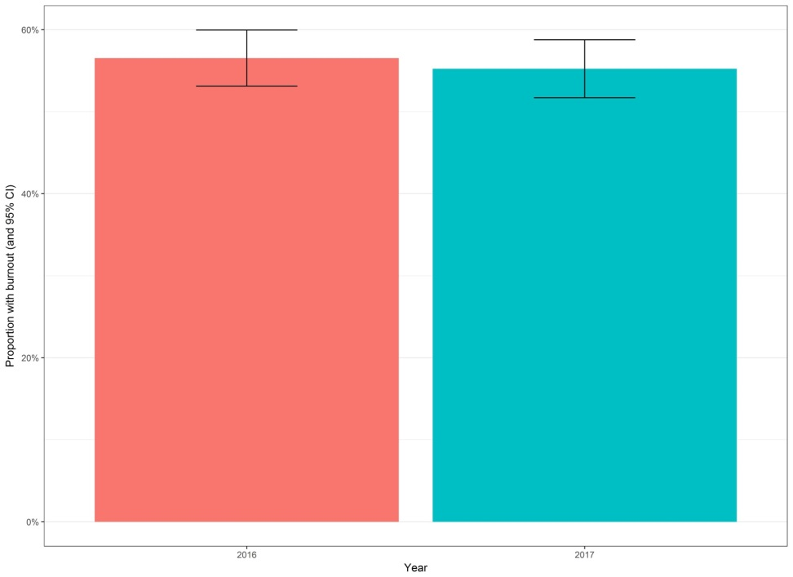
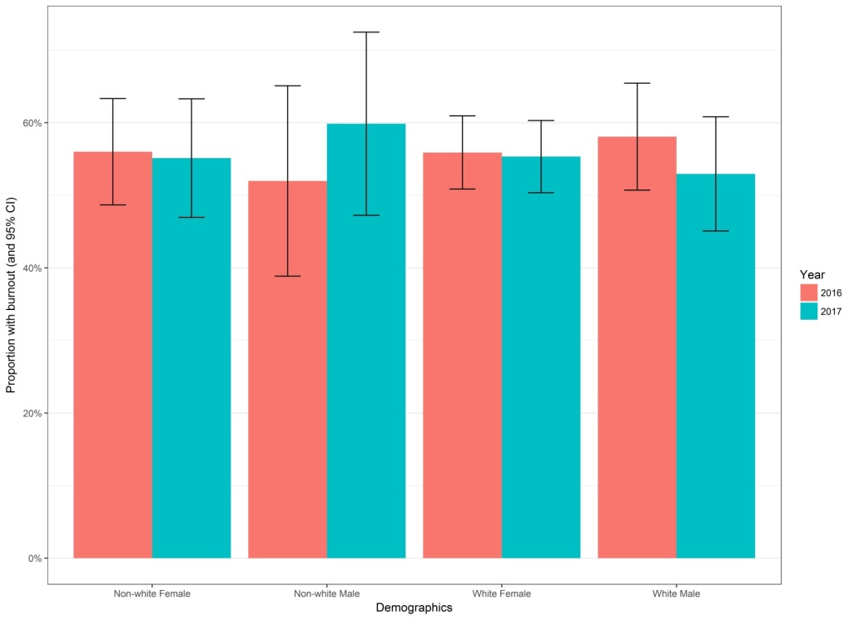
PRB-RSC Demographics 2016 vrs 2017
Notes:
Program participation in PRB-RSC voluntary
Dependent on self-reporting
Cross-sectional study design
Program participation in PRB-RSC voluntary
Dependent on self-reporting
Cross-sectional study design

Slide 13
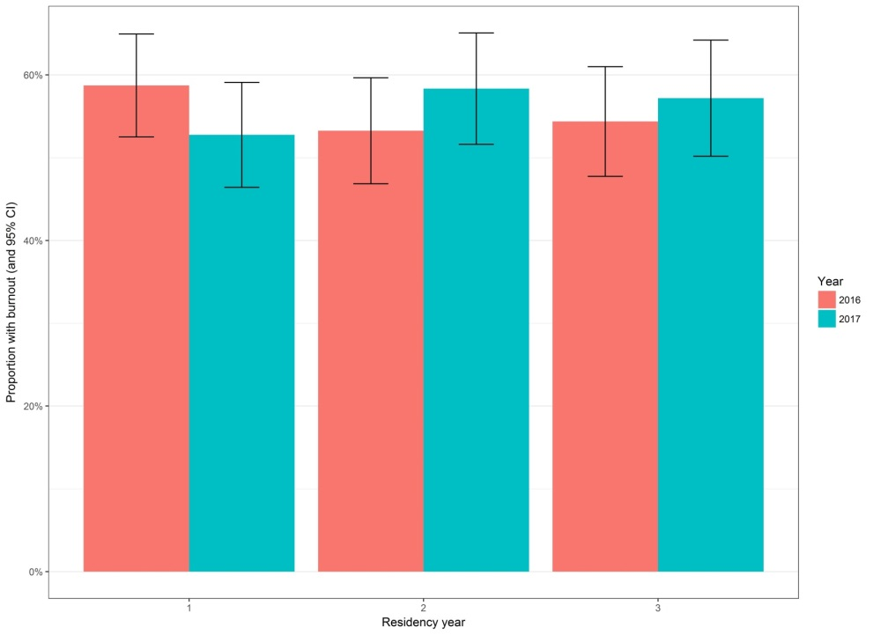
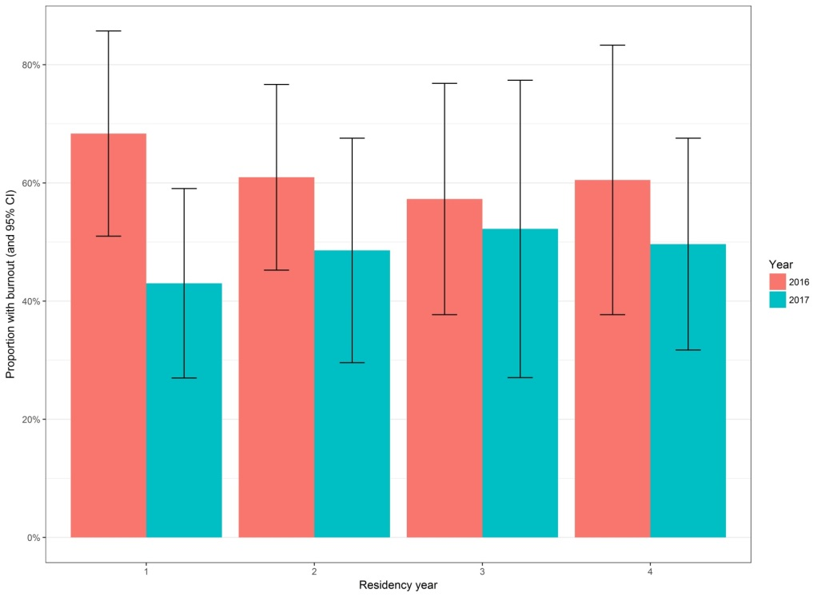
PRB-RSC Burnout – Categorical Pediatrics by Training Year 2016 vrs 2017
Pediatrics
Medicine- Pediatrics

Slide 14
PRB-RSC Program Reports

Slide 15
PRB-RSC Program Reports

Slide 16
Future Developments
Research/Scholarship
Wilson P. 2016 Program Wellness Interventions - accepted
Batra M. 2016 Burnout in Pediatric Residents – TBS
Reed S. 2016 Predictors of Burnout – submitted
Staples B. Burnout Impact on Performance (Milestones) – TBS
Mahan J. Resilience in Pediatric Residents – TBS
Schwartz A. Key Burnout Questions in Pediatric Residents – TBS
Member Initiated Projects – New Mechanism
Sox C. Mindfulness in Pediatric Residents – under review
Pitt M. Spirituality in Pediatric Residents – under construction
You ????????

Slide 17
Future Developments
Program Director Reports
Interventional Trials
2018-2019 – Call for Proposals this Fall
Number to approve?
Participation offered to PRB-RSC sites
Willingness to sign on!

Slide 18
Resident Wellness Interventions
Existing Evidence
Scare
Intervention Studies Support
Organizational/System
Modify clinical work processes
Individual
Self-Care (sleep, diet, exercise, support)
Mindfulness
Meditation
Yoga
Stress Management
Opportunities
West C. Lancet 2016
Notes:
Interventions to prevent and reduce physician burnout: a systematic review and meta-analysis
Colin P West, Liselotte N Dyrbye, Patricia J Erwin, Tait D Shanafelt
Summary
Background Physician burnout has reached epidemic levels, as documented in national studies of both physicians in training and practising physicians. The consequences are negative eff ects on patient care, professionalism, physicians’ own care and safety, and the viability of health-care systems. A more complete understanding than at present of the quality and outcomes of the literature on approaches to prevent and reduce burnout is necessary.
Methods In this systematic review and meta-analysis, we searched MEDLINE, Embase, PsycINFO, Scopus, Web of Science, and the Education Resources Information Center from inception to Jan 15, 2016, for studies of interventions to prevent and reduce physician burnout, including single-arm pre-post comparison studies. We required studies to provide physician-specifi c burnout data using burnout measures with validity support from commonly accepted
sources of evidence. We excluded studies of medical students and non-physician health-care providers. We considered potential eligibility of the abstracts and extracted data from eligible studies using a standardised form. Outcomes were changes in overall burnout, emotional exhaustion score (and high emotional exhaustion), and depersonalisation score (and high depersonalisation). We used random-eff ects models to calculate pooled mean diff erence estimates for changes in each outcome.
Findings We identifi ed 2617 articles, of which 15 randomised trials including 716 physicians and 37 cohort studies including 2914 physicians met inclusion criteria. Overall burnout decreased from 54% to 44% (diff erence 10% [95% CI 5–14]; p<0·0001; I²=15%; 14 studies), emotional exhaustion score decreased from 23·82 points to 21·17 points (2·65 points [1·67–3·64]; p<0·0001; I²=82%; 40 studies), and depersonalisation score decreased from 9·05 to 8·41 (0·64 points [0·15–1·14]; p=0·01; I²=58%; 36 studies). High emotional exhaustion decreased from 38% to 24% (14% [11–18]; p<0·0001; I²=0%; 21 studies) and high depersonalisation decreased from 38% to 34% (4% [0–8]; p=0·04; I²=0%; 16 studies).
Interpretation The literature indicates that both individual-focused and structural or organisational strategies can result in clinically meaningful reductions in burnout among physicians. Further research is needed to establish which interventions are most effective in specif c populations, as well as how individual and organisational solutions might be combined to deliver even greater improvements in physician wellbeing than those achieved with individual
solutions.
Of 15 RCT, 7 involved residents – 2 peds residents ; 1 UC-Davis psychotherapeutic method (Milstein 15 randomized residents - no benefit Med Teach 2009); 1 Argentinian Hospital General de Ninos Buenos Aires self-care workshops over 2 months (Martins 67 randomized residents – no benefit J Ped – Rio 2011)

Slide 19
Participating Institutions
2016 and 2017; 2016 only; 2017 only
Albert Einstein College of Medicine
Baylor College of Medicine/Texas Children’s
Boston Children’s Hospital
Carolinas Medical Center
Case Western/Rainbow Babies and Children's
Crozer-Chester Medical Center
Dartmouth
Drexel/St Christopher’s
Duke U
Inova Fairfax Medical Campus
Jefferson Medical College/duPont Hospital for Children
Johns Hopkins U
Louisiana State U
Maine Medical Center
Mayo Clinic College of Medicine
Medical College of Wisconsin
New York Presbyterian/Cornell
Northwestern U/Lurie Children's
Ohio State U/Nationwide Children's
Rush U
Tufts Medical Center
U of Alabama
U of Arizona
U of California Davis
U of California Los Angeles/Mattel Children’s
U of California San Diego/Rady Children’s
U of Chicago/ Corner Children’s Hospital
U of Cincinnati/Cincinnati Children’s
U of Colorado/Denver Children's
U of Florida/Shands Hospital
U of Illinois - Chicago
U of Indiana
U of Kansas
U of Louisville
U of Michigan
U of Minnesota
U of New Mexico
U of Oklahoma - Oklahoma City
U of Oklahoma - Tulsa
U of Pennsylvania/Children's Philadelphia
U of Pittsburgh
U of South Alabama
U of Washington/Seattle Children's
U of Wisconsin
Virginia Tech – Carilion
Wright State

Slide 20
http://pedsresresilience.com

Slide 22
Resident Experiences and Burnout
Resident experiences | No Burnout (n=750) | Burnout (n=940) | p-value
Current rotation |  |  | 0.001
ICU/ER/Inpatient | 41% | 50%
Elective/Ambulatory/Nursery/Research | 46% | 39%
Other | 13% | 11%
Last vacation (months ago) |  |  | 0.013
<1 | 25% | 20%
1-3 | 38% | 45%
4-6 | 25% | 26%
7-9 | 9% | 7%
>9 | 3% | 2%
Last full weekend off (weeks ago) |  |  | 0.001
1 | 51% | 39%
2 | 20% | 22%
3 | 15% | 16%
4+ | 14% | 23%
Sleepiness (Epworth Sleep Scale) | 8.7 | 10.6 | 0.001
Major Medical Error in last 3 months | 11% | 24% | 0.001

